Slide 1
Dart Scoring System Preliminary Design Review
EN.525.743 – Embedded Systems Development Laboratory
Kevin Parlak

Slide 2
Agenda
Project Description
Capabilities & Limitations
Functional Description
Functional Flow
State Machines
Interface Description
Material Requirements

Slide 3
Project Description
Problem: Currently own steel-tipped dart board with no means of keeping score
Solution: Utilize computer vision techniques to track where dart lands and report score back to user interface
Computer vision will report dart location and associated score
Based on known dataset with training as game is played
Database will hold score information and be accessible via touchscreen display or mobile device
Bigger Picture:
System will be capable of two games at first – expansion of game selection easy once concept is complete
Machine learning possible based on user data over time – help user get better at playing

Slide 4
Capabilities & Limitations
Able to add up to 100 players to database for scoring
Display will show live hit map
Database to produce statistics (hit % by color or number, win %)
Database accessible anywhere with access to home network
Multi-platform mobile application (Android/iOS) for viewing statistics and game
Single set (3 darts) will be tracked at a time (users to select profile when throwing)
Host two games (one score, one knockout)
Games can only be started via user interface at dart board (similar to TopGolf)
Two player limit (dart rules)
One dart thrown at a time (dart rules)
Profiles can only be created at user interface

Slide 5
Functional Description
User will start game, select profile, and choose game to play via touchscreen user interface
Imaging system will begin looking for dart once user profile is selected
Will use known datasets to identify dart tip location, map to dartboard, and send to scoring system
Scoring system will receive update and calculate statistics and score
Will upload to database and update live hit map for viewing on user interface and mobile device
System will repeat until winner is declared or game is ended
Mobile app will show user statistics and scores

Slide 6
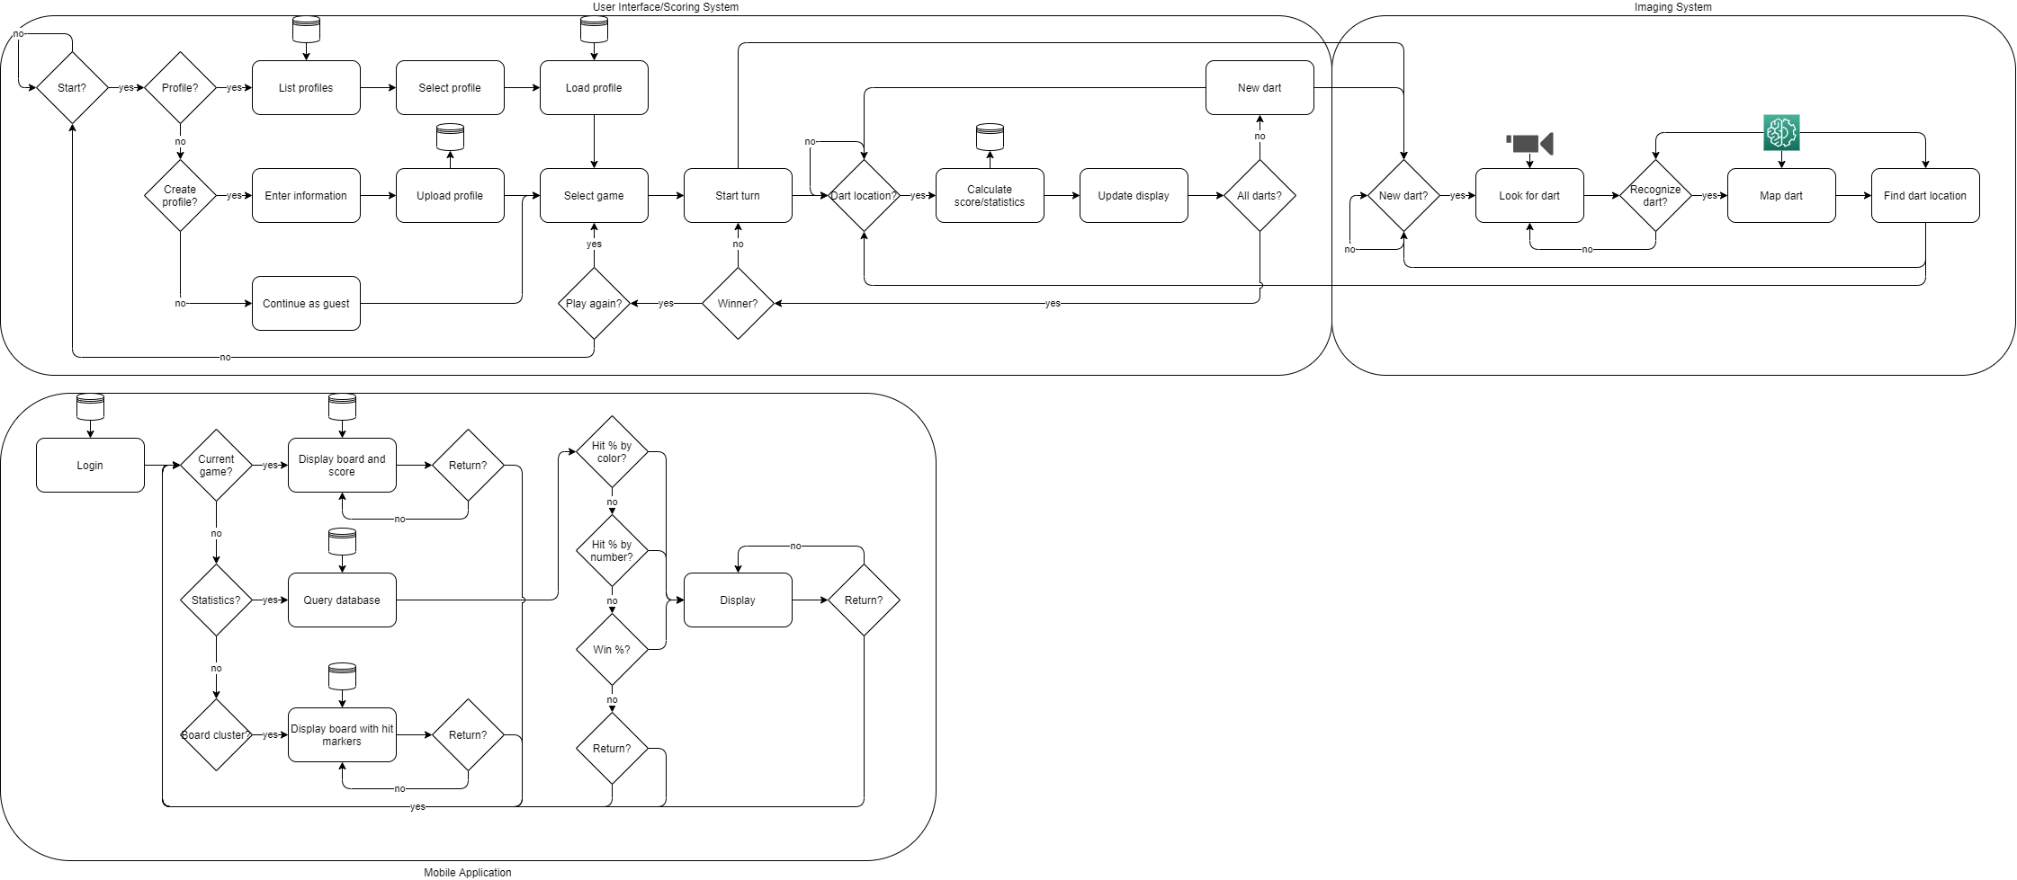
Functional Flow

Slide 7
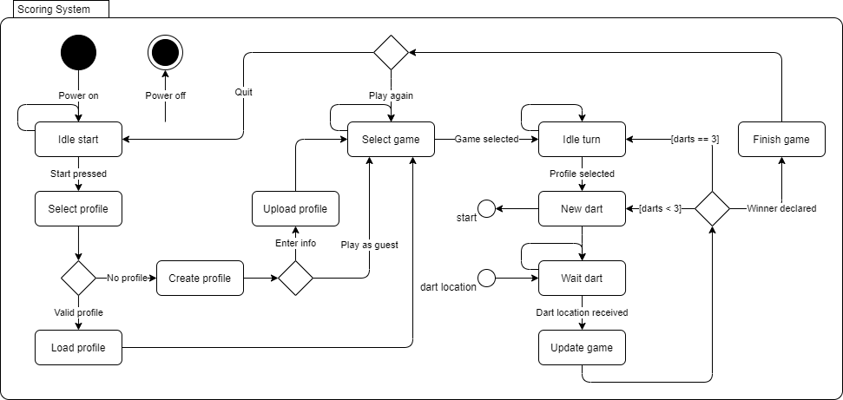
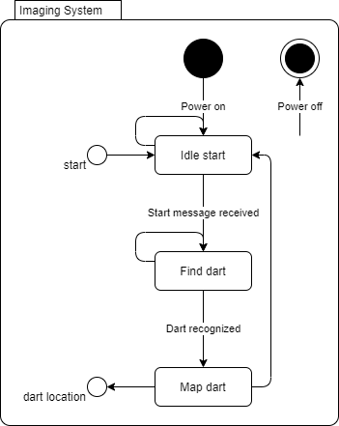
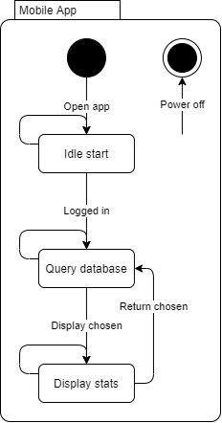
State Machines
Scoring and imaging state machines dependent on each other

Slide 8
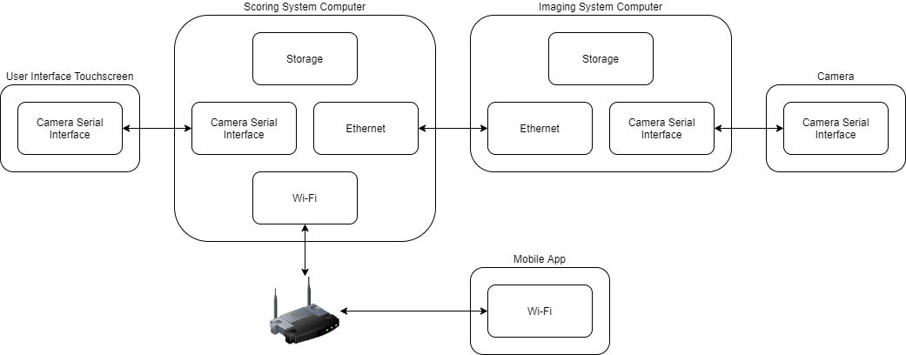
Interface Description

Slide 9
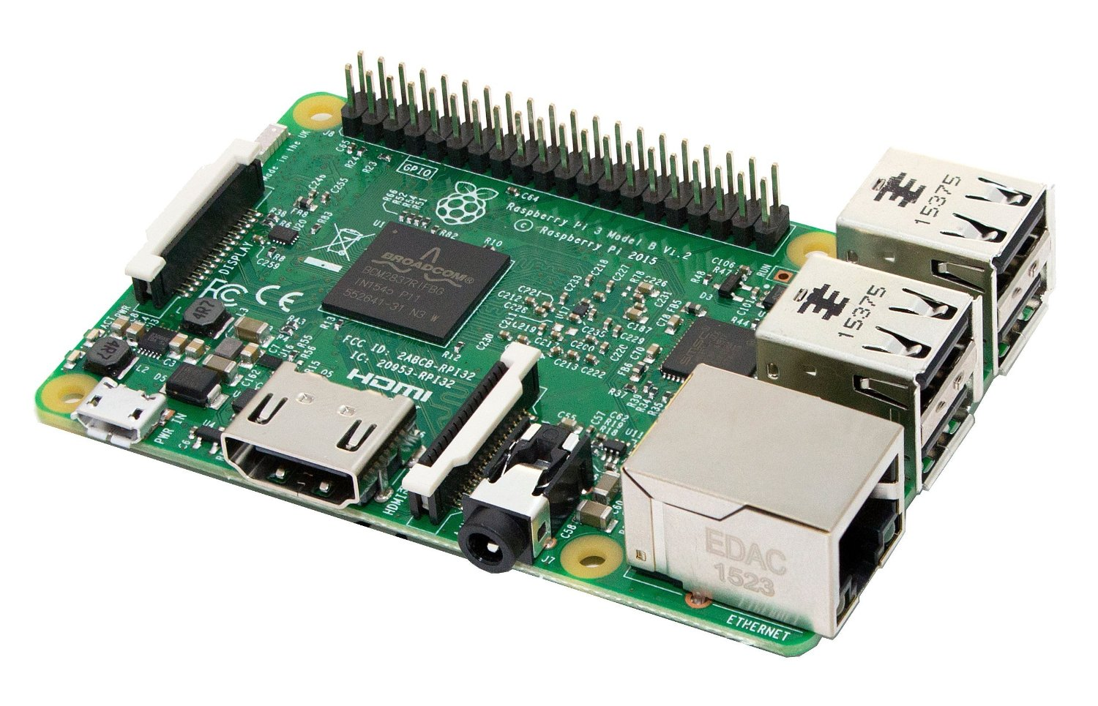
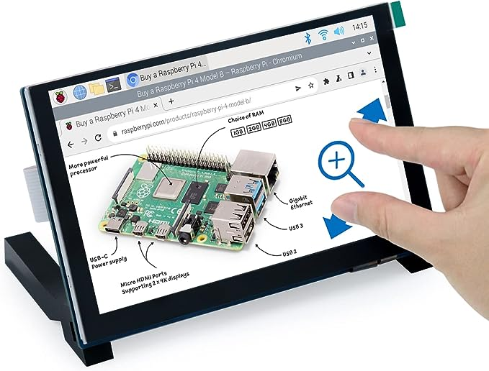
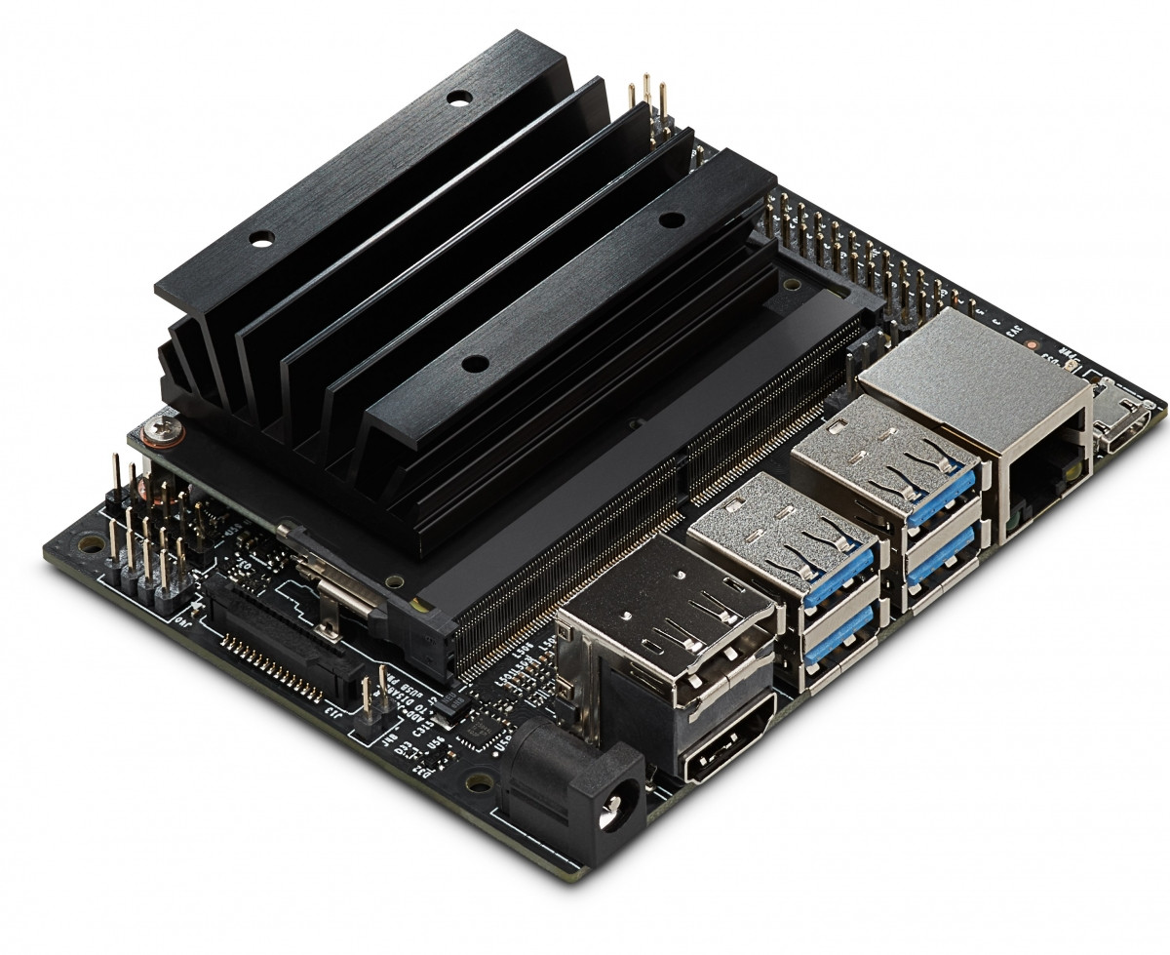
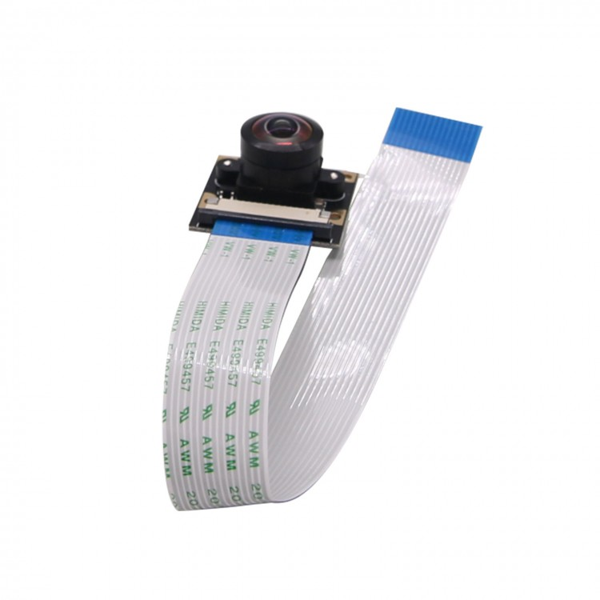
Material Requirements
Scoring System
Raspberry Pi 3B+ with Wi-Fi, Ethernet, and Camera Serial Interface (CSI) connectivity
User Interface
FREENOVE touchscreen monitor for interaction with Pi via CSI
Imaging System
Nvidia Jetson Nano with Ethernet and CSI connectivity
Camera
SainSmart IMX219 8MP module for interaction with Jetson via CSI
Materials readily available and already acquired

Slide 10
Backup

Slide 11
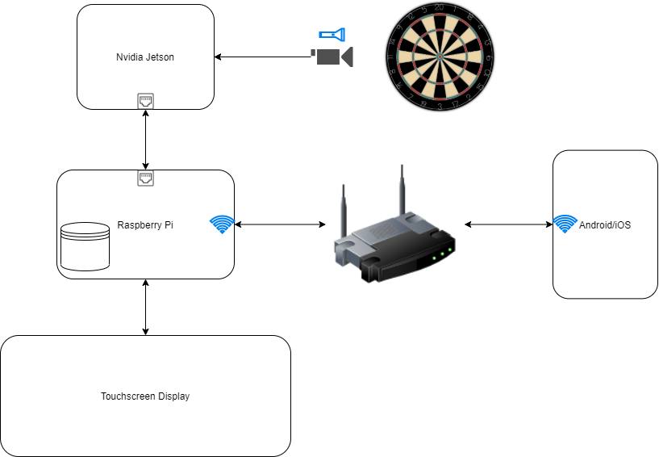
Concept Diagram
Jetson will use CV to produce dart position and score
User can use mobile app to view statistics and current score
Pi will receive message from Jetson when position has been identified
User will select player when ready to throw

